Slide 1
Food Budgeter
Akia Vongdara and Tim Wong

Slide 2
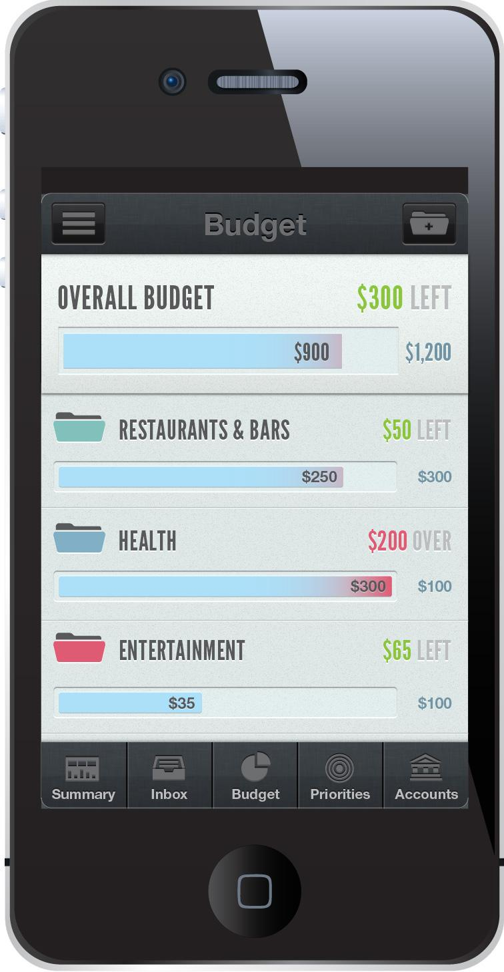
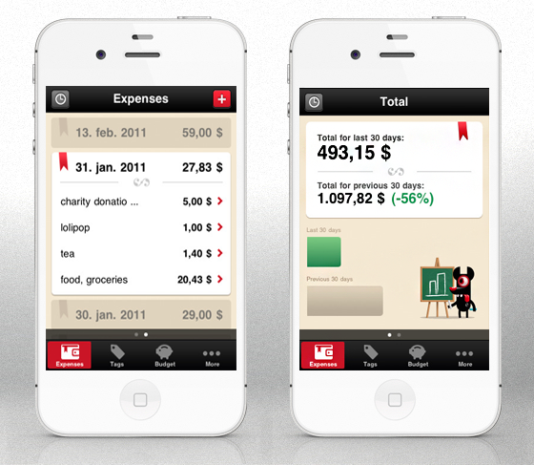
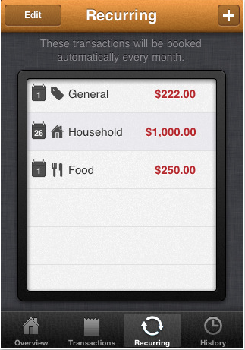
Analysis - The Competitors
Toshl
MoneyBook
Mint

Slide 3
What is it?
Calculates how much a user is spending on food in both cooking and purchases.
Allows users to know how much they can save.

Slide 4
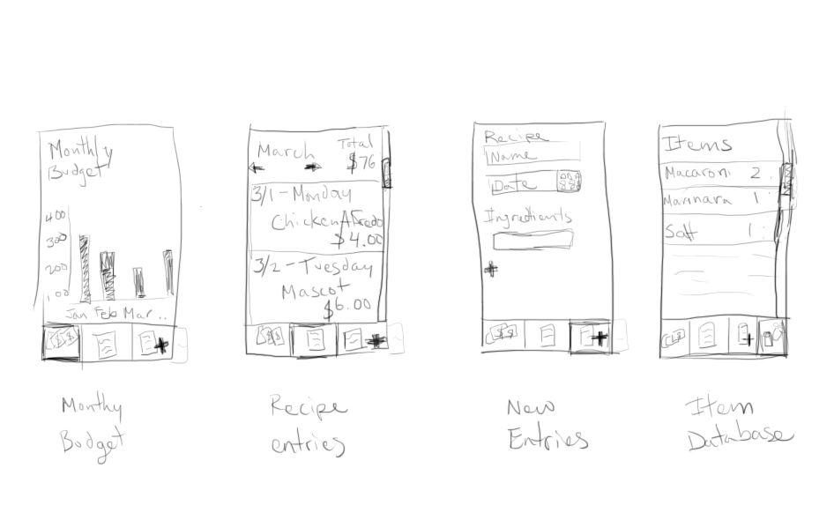
Sketches

Slide 5
Design - Purchased Food
Users enter in the name and cost of the food, then submit it to the database.

Slide 6
Design - Recipes
Users input name and ingredients (from a grocery list) used to make the food, then submit it to the database.
If the ingredient is unavailable, the user must enter in an item to the "Grocery".
**Ingredients are portions of a grocery item.

Slide 7
Recipe Item Calculations
Grilled Cheese Sandwich
Grocery Items
Wonder Bread: $2.00, 20 slices
Krafts Cheese: $3.50, 24 slices
Ingredients
Wonder Bread: 2 slices
Krafts Cheese: 2 slices
Cost of Wonder Bread Slices
2 slices / 20 slices = 1 / 10
1 / 10 * $2.00 = $0.20
Cost of Krafts Cheese
2 slices / 24 slices = 1 / 12
1 / 12 * $3.50 = $0.15
Total Cost of the Grilled Cheese
$0.35

Slide 8
Monthly Budget
Each log is given a date. So, from that date, we can select items within a range of dates, and add up all the costs (for that month).

Slide 9
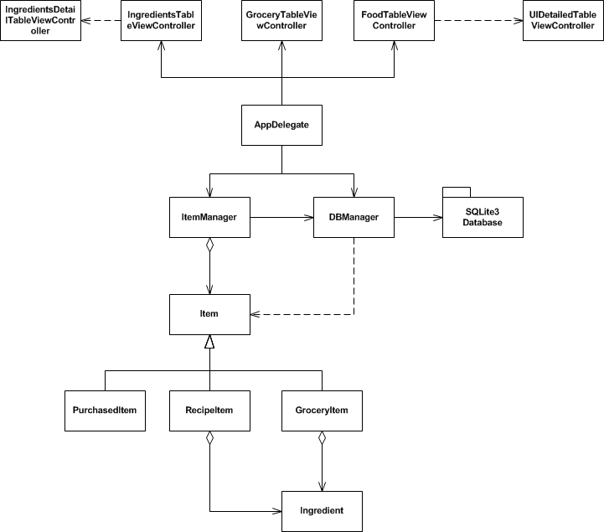
UML

Slide 10
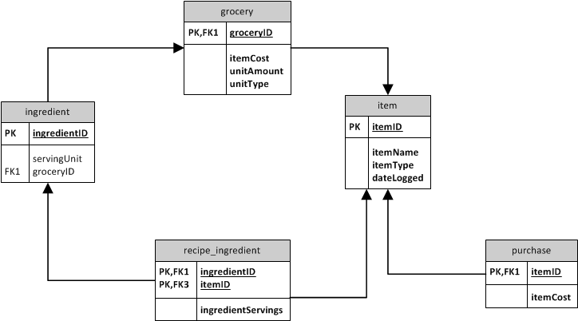
Database Model

Slide 11
What worked and didn't work
Worked
Adding and Removing Items
Viewing Items
General Budget
Database Operations
Didn't Work
Monthly Budget
Calculating Recipes (in application)

Slide 12
Demo

